Slide 1
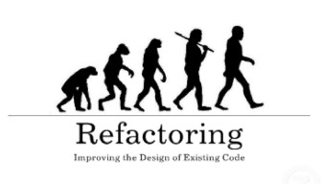

Refactoring: Improving the Quality of Existing Code
When and How to Refactor? Refactoring Patterns
Alexander Vakrilov
Senior Developer and Team Leader
Telerik Corporation
www.telerik.com

Slide 2

What is Refactoring?
Refactoring means "to improve the design and quality of existing source code without changing its external behavior".
Martin Fowler
It is a step by step process that turns the bad code into good code
Based on "refactoring patterns" → well-known recipes for improving the code

Slide 3
Code Refactoring
What is refactoring of the source code?
Improving the design and quality of existing source code without changing its behavior
Step by step process that turns the bad code into good code (if possible)
Why we need refactoring?
Code constantly changes and its quality constantly degrades (unless refactored)
Requirements often change and code needs to be changed to follow them

Slide 4

When to Refactor?
Bad smells in the code indicate need of refactoring
Refactor when you
Add a new method or class
Fix an existing bug
Reviewing someone else’s code
Unit tests guarantee that refactoring does not change the behavior
If there are no unit tests, write them

Slide 5

Code Smells
Duplicated code
Long method
Large class
Long parameter list
Switch statements
Temporary field
Bad comments / comments for bad code
Improper naming
Data members are public

Slide 6

Code Smells (2)
Global variables
Overused primitives
Divergent change
Shotgun surgery
Feature envy
Middle man
Speculative generality
Inappropriate Intimacy

Slide 7

Data Level Refactorings
Replace a magic number with a named constant
Rename a variable with more informative name
Replace an expression with a method
Introduce an intermediate variable
Convert a multi-use variable to a multiple single-use variables
Convert a data primitive to a class
Change an array to an object
Encapsulate a collection

Slide 8

Statement Level Refactorings
Decompose a boolean expression
Move a complex boolean expression into a well-named boolean function
Return as soon as you know the answer instead of assigning a return value (?)
Use break or return instead of a loop control variable
Replace conditionals with polymorphism

Slide 9

Method Level Refactorings
Extract method
Inline method
Add / remove parameter
Combine similar methods by parameterizing them
Separate methods whose behavior depends on parameters passed in
Pass a whole object rather than specific fields
Encapsulate downcast

Slide 10
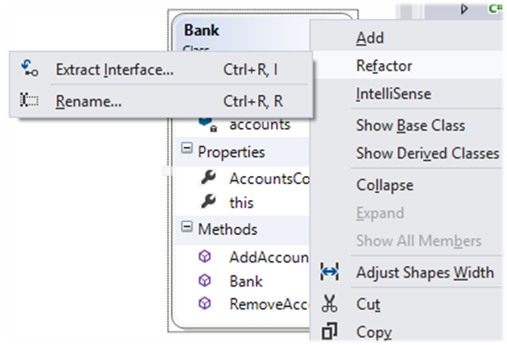
Class Level Refactorings
Change structure to class and vice versa
Replace virtual routines with data initialization
Pull members up / push members down the hierarchy
Extract specialized code into a subclass
Combine similar code into a superclass

Slide 11
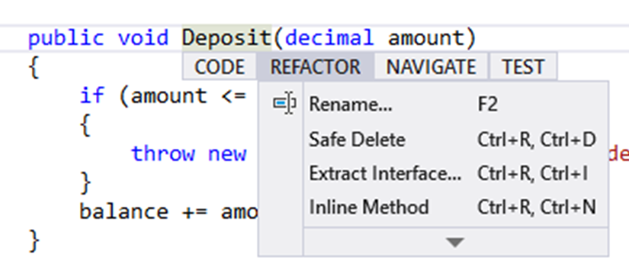
Class Interface Refactorings
Move a method to another class
Convert a class to two
Delete a class
Hide a delegating class
Remove the man in the middle
Introduce (use) an extension class
Encapsulate an exposed member variable

Slide 12
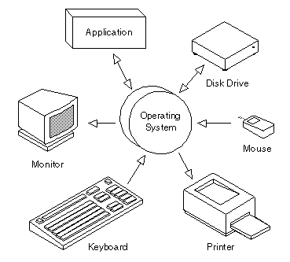
System Level Refactorings
Move class (set of classes) to another namespace
Provide a factory method instead of a simple constructor
Replace error codes with exceptions
Extract strings to resource files

Slide 13
Refactoring Tips
Save the code you start with
Make sure you have tests to assure the behavior after the code is refactored
Do refactorings one at a time
Keep refactorings small
Check-in and test often
Don’t underestimate small changes

Slide 14
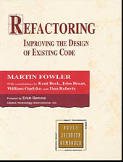


Refactoring Patterns
Well-Known Recipes for Improving the Code Quality

Slide 15
Rafactoring Patterns
When should we perform refactoring of the code?
Bad smells in the code indicate need of refactoring
Unit tests guarantee that refactoring does not change the behavior
Rafactoring patterns
Large repeating code fragments → extract repeating code in separate method
Large methods → split them logically
Large loop body or deep nesting → extract method

Slide 16
Refactoring Patterns (2)
Refactoring patterns
Class or method has weak cohesion → split into several classes / methods
Single change carry out changes in several classes → classes have tight coupling → consider redesign
Related data are always used together but are not part of a single class → group them in a class
A method has too many parameters → create a class to groups parameters together
A method calls more methods from another class than from its own class → move it

Slide 17
Rafactoring Patterns (3)
Refactoring patterns
Two classes are tightly coupled → merge them or redesign them to separate their responsibilities
Public non-constant fields → make them private and define accessing properties
Magic numbers in the code → consider extracting constants
Bad named class / method / variable → rename it
Complex boolean condition → split it to several expressions or method calls

Slide 18
Rafactoring Patterns (4)
Refactoring patterns
Complex expression → split it into few simple parts
A set of constants is used as enumeration → convert it to enumeration
Method logic is too complex and is hard to understand → extract several more simple methods or even create a new class
Unused classes, methods, parameters, variables → remove them
Large data is passed by value without a good reason → pass it by reference

Slide 19
Rafactoring Patterns (5)
Refactoring patterns
Few classes share repeating functionality → extract base class and reuse the common code
Different classes need to be instantiated depending on configuration setting → use factory
Code is not well formatted → reformat it
Too many classes in a single namespace → split classes logically into more namespaces
Unused using definitions → remove them
Non-descriptive error messages → improve them
Absence of defensive programming → add it

Slide 20

Code Refactoring
Live Demo

Slide 21
Code Refactoring
http://academy.telerik.com

Slide 22
Exercises
Refactor the C# code from the Visual Studio Project "12. Refactoring-Homework.zip" to improve its internal quality. You might follow the following steps:
Make some initial refactorings like:
Reformat the code.
Rename the ugly named variables.
Make the code testable.
Think how to test console-based input / output.
Write unite tests. Fix any bugs found in the mean time.
Refactor the code following the guidelines from this chapter. Do it step by step. Run the unit tests after each major change.

Slide 23




Free Trainings @ Telerik Academy
C# Programming @ Telerik Academy
csharpfundamentals.telerik.com
Telerik Software Academy
academy.telerik.com
Telerik Academy @ Facebook
facebook.com/TelerikAcademy
Telerik Software Academy Forums
forums.academy.telerik.com

